Slide 1
Magnecraft™ 750R/788R Plug-In Relays
Sales Presentation
2014

Slide 2
Magnecraft 750R/788R Plug-In Relay
Agenda:
Session Objectives
Product Offer
Competitive Comparison
Available Support Tools
Call to Action
Notes:
The agenda for today will begin with this session’s objectives, followed by a review of the relay product offer, Competitive Cross Reference, Application Memos, available support tools, and conclude with a call to action

Slide 3

Session Objectives
By the end of this presentation you will know:
The unique value propositions for the 750R/788R relay
The applications where these relays are used
Target customers and markets
Advantages against the competition
Sales strategies
Available support tools and resources
Notes:
By the end of this session, you will know the 750R/788R’s unique value propositions, their primary applications, their target customers and markets, and their advantages over the competition. You will also learn which sales strategies to use, where you can find support tools and resources, and whom to contact for technical support.

Slide 4
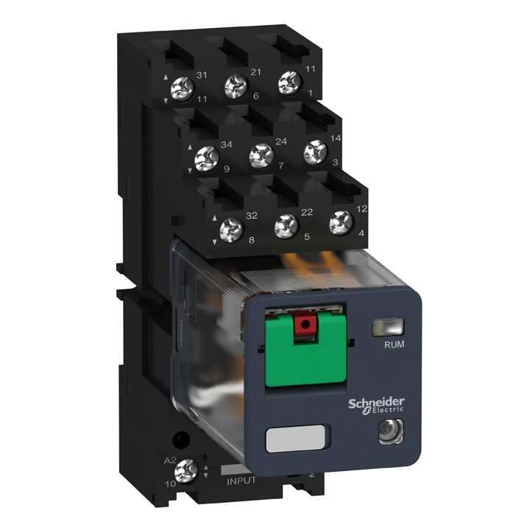






Magnecraft 750R/788R Product Offer
Rated up to 10A and 1 Horsepower
  Ideal for controlling motors and pumps
2 and 3 Pole Models
  Saves space in automation panels
Octal and Blade Style Terminal Models
  The 750R series features Octal style terminals
  The 788R series features Blade (or Quick Connect) style Terminals
Notes:
They are an industry standard plug-in relay and socket design, but as you’ll see our product features differentiate us from the competition.
With ratings up to 10 A and 1 Horsepower, the 750R/788R relays are ideal for controlling small motors and pumps.
2 and 3 pole models allow you to simultaneously control separate, individual circuits while conserving precious panel space
the major distinction between the two series is that the 750R features Octal style pins where as the 788R has Blade, or Quick Connect, style terminals at the base of the relay.

Slide 5
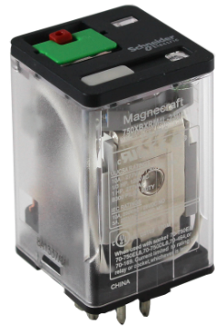
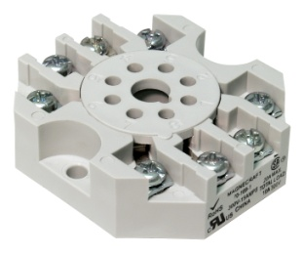
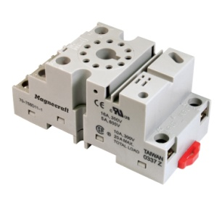
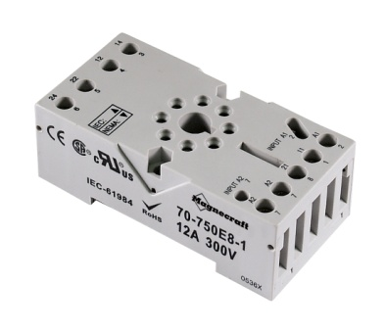
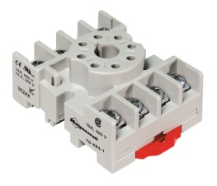
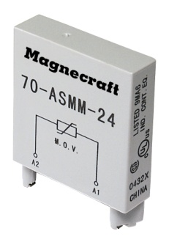
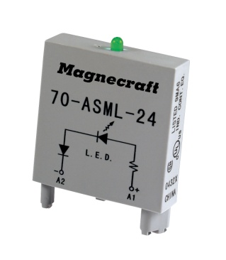


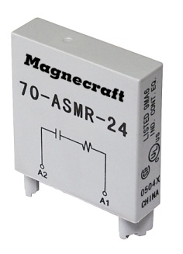
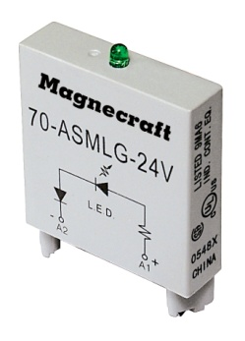

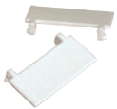
Magnecraft 750R Complete System Solution
Signature Full-Feature Cover
  Test Button + Lock-Down Door
  LED, Mechanical Flag Indicator
  Gold-Flashed Contacts
  Octal Style Base
Sockets and Mounting Adapters
  Mixed and Separate Terminal Styles Available
  Din Rail and Panel Mount Styles Available
Modules
  LED Indicator
  Protection Diode
  MOV Suppressor
  R/C Suppressor
Additional Accessories
  Hold Down Clips
  Bus Jumper
  ID Tags
Notes:
The 750R family stands apart from competition due to our “Complete System Solution”, which means the complete installation (socket, relay, clips, bus jumpers … whatever components you choose) are UL Listed as a complete product when your installation is finished.
What are our differentiators …
1st Our signature full-feature cover incorporates a test button with a lock-down door along with LED and mechanical flag indicator. Why is this important – you can check the connections and wiring without having to power ON the relay. This gives the installer a measure of convenience and some protection and also reduces the risk of mis-wiring which could lead to equipment damage.
2nd Our sockets and accessories – We have one of the broadest line of sockets in the industry, this includes Mixed and Separate style Terminals, as well as options for din rail or panel mount to suit your applications need. These sockets give customers the option of incorporating protection modules, which help protect the installation from surges and transients that may come through the control panel, along with hold down clips, bus jumpers, and ID tags.
3rd – as noted earlier, our “Complete System Solution” is UL Listed.
And finally, our gold-flash contacts decrease contact oxidation. Why is this
important?
First time performance after long periods of inactivity
And increased shelf life for distributor stock and customer spares

Slide 6
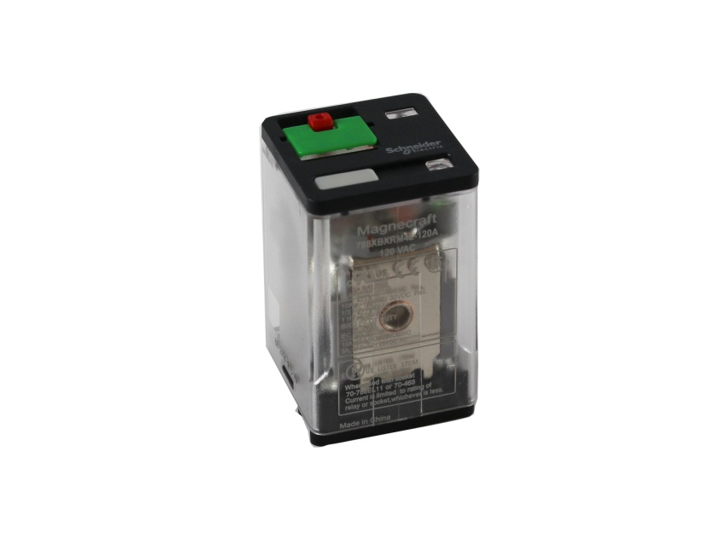
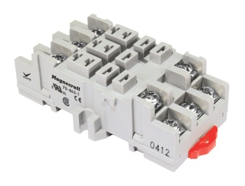
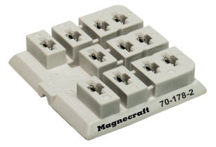
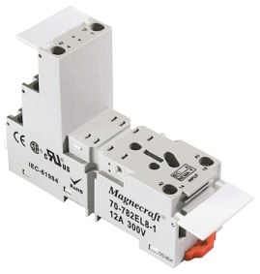
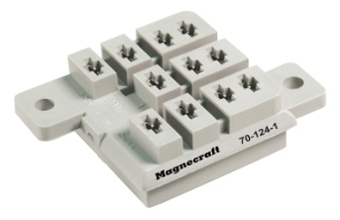
Magnecraft 788R Complete System Solution
Signature Full-Feature Cover
  Test Button + Lock-Down Door
  LED, Mechanical Flag Indicator
  Gold-Flashed Contacts
  Blade Style Base
Sockets and Mounting Adapters
  Mixed and Separate Terminal Styles Available
  Din Rail, Panel, Chassis, and PCB Mounting Styles Available
Modules
  LED Indicator
  Protection Diode
  MOV Suppressor
  R/C Suppressor
Additional Accessories
  Hold Down Clips
  Bus Jumper
  ID Tags
Notes:
The Very same things can be said for the 788R series.
While different sockets are required to accommodate the different base styles. You can see here that they are very similar products. In fact the modules, bus jumpers, and ID tags are interchangeable between the 2 series.

Slide 7

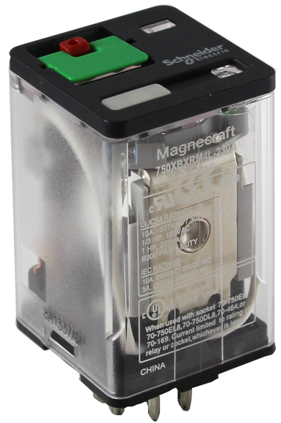
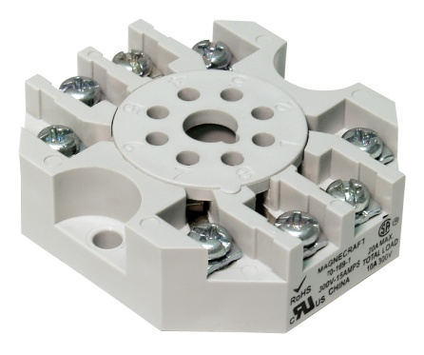
Magnecraft 750R/788R Competitive Comparison
 | Magnecraft 750R / 788R | Omron MK / MJ | Idec RR | Tyco KRPA / KUP
Gold flashed Contacts | YES | NO | NO | NO
Locking Test Button | Signature Flip-Open | NO Test Button; Pull-Out Tab | NO | NO
Flag Indicator | YES | YES | NO | NO
UL Listing |  | NO | NO | NO
Bus Jumpers | YES | Socket “bridge” Offered | Only Spring Clip Socket | NO
Protection Modules | YES | NO | NO | NO
ID Tags | YES | YES | NO | NO
Relay & Socket
Combination
UL Listed
Notes:
A quick look at the competition and you’ll see that the Magnecraft 750R and 788R series has a clear advantage in terms of features and performance.
And don’t forget … the “Complete System Solution” is a huge benefit for OEM’s and Panel Builders … a UL Listed Relay and Socket combination.

Slide 8
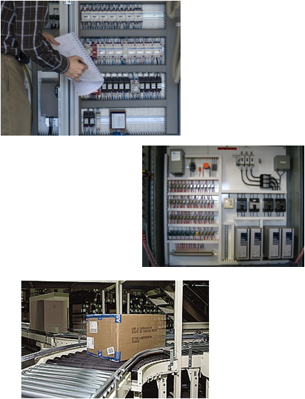
Magnecraft 750R/788R Applications
Packaging Equipment
  Conveyor Motors
  Product Shrink Wrap
  Solenoid Controls
Material Handling Equipment
  Motor Control
  Conveyor Control
HVAC & Refrigeration Controls
  Anti-Condensation Equipment
  Compressor & Blower Controls
Power Supplies
  Industrial Units
  UPS & Battery Backup
Notes:
Packaging equipment, material handling equipment, HVAC, and Refrigeration applications all use relays for controlling motors, solenoids, compressors, and blowers.

Slide 9
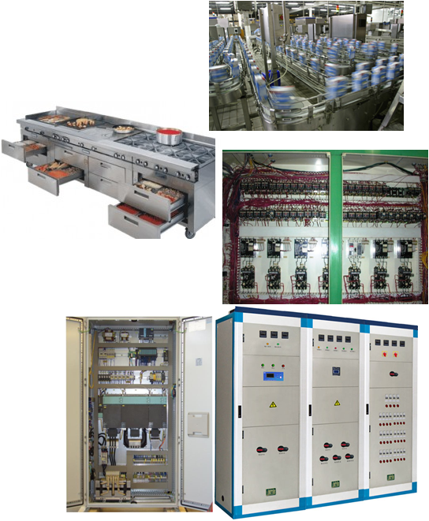
Magnecraft 750R/788R Applications
Food and Beverage Processing
  Commercial/Industrial cooking equipment
  Filtration systems
  Bottling controls
  Chilling units
Lighting Controls
  Traffic signal systems
  Motorway information systems
  Ballast lighting systems
Appliances
  Air conditioners
  Water heaters
  Spa controls / water pumps
Notes:
Relays are also used in industrial ovens, bottling controls, ballast lighting systems, air conditioners, water pumps.

Slide 10
Magnecraft 750R/788R Relay Support Resources
Web Page
  Magnecraft 750R Series Relays
  Magnecraft 788R Series Relays
  Magnecraft General Purpose Relays - Overview
Catalogs
  Magnecraft 750R Plug-In Relay Data Sheet
  Magnecraft 788R Plug-In Relay Data Sheet
eLaunch Document
  Magnecraft 750R/788R Plug-In Relay eLaunch Document
Web Tools
  Magnecraft 700 Series Parametric Search
  Magnecraft Socket Tool
Notes:
Links to all relevant support material can be found at www.serelays.com
SERelays.com provides you with the ability to download 2D/3D CAD drawings, Product Images, Interactive eCatalogs, Parametric Search, Environmental Considerations, and much more!

Slide 11

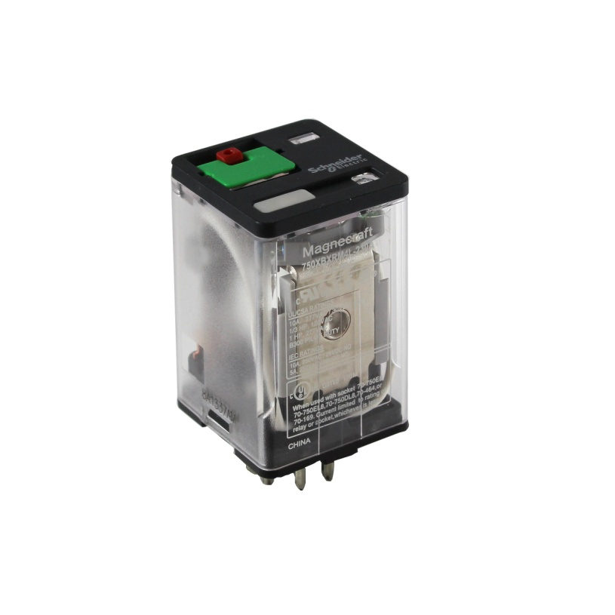
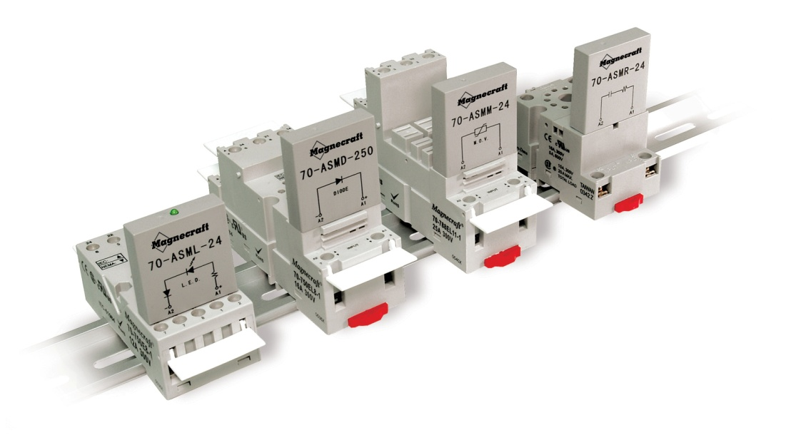
Call to Action
Review all available sales support material
Engage customers already using 750 and 788 relays
and present the new 750R and 788R Magnecraft series
Identify customers using competitor products
and convert to Magnecraft

Slide 12
Summary
Magnecraft Plug-In Relays deliver the “Complete System
Solution” to simplify any design and expedite installation.
The 750R/788R Relay Series optimizes flexibility with
Magnecraft’s signature full-feature cover, sockets, panel &
DIN mounting options, protection modules, and other
accessories.
The Magnecraft Advantage comes not only from the reliability,
simplicity and design innovation found in the entire relay offer,
but also from the web tools and online resources found at
www.serelays.com

Slide 13
Magnecraft™ 750R/788R Plug-In Relays
Sales Presentation
2014
Thank You!

